Slide 1
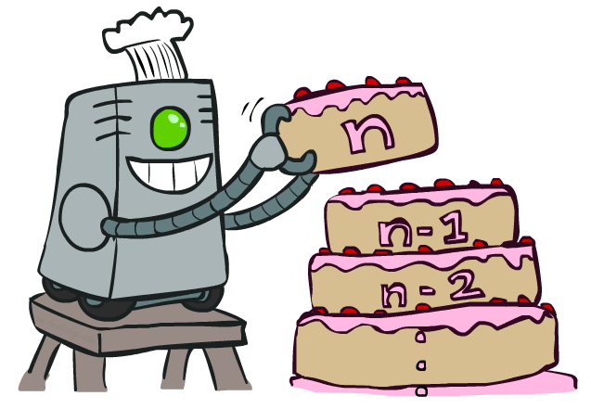
CS7050 Artificial Intelligence
Markov Decision Processes - Part II Value Iteration
[With thanks to Dan Klein and Pieter Abbeel from UC Berkeley. http://ai.berkeley.edu.]
Notes:
Please retain proper attribution, including the reference to ai.berkeley.edu. Thanks!

Slide 2
Value Iteration
Start with V₀(s) = 0: no time steps left means an expected reward
sum of zero (final reward)
Given vector of V₀(s) values, do one ply of heuristic search-based
move from each state
Consider arbitrary state s_{i} for which to calculate the value V_{k}(s_{i}).
You can do it by accounting the sum of the rewards up to this
moment V_{k} (s_{i-1})
Repeat iteratively until convergence of the vector
Complexity of each iteration: O(S²A)
V_{k+1}(s)
a
s, a
s,a,s’
V_{k}(s’)
Notes:
Discuss computational complexity: S * A * S times number of iterations
Note: updates not in place [if in place, it means something else and not even clear what it means]

Slide 3
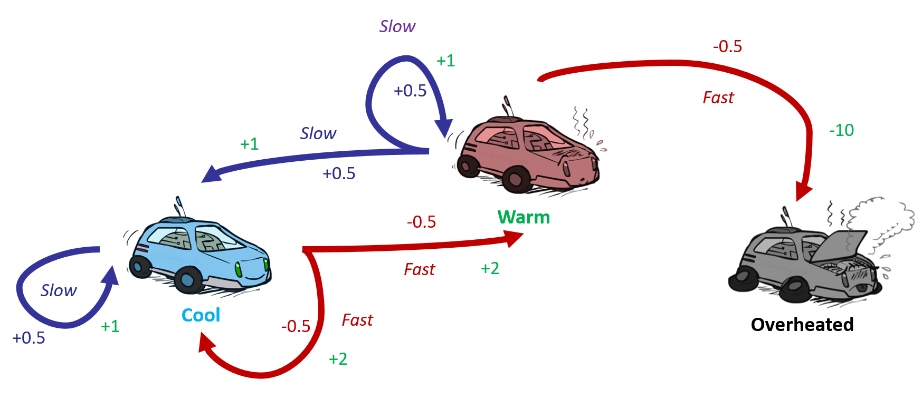


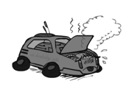
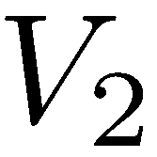
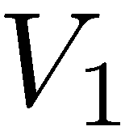
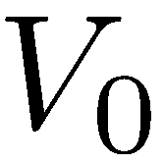
Example: Value Iteration
3.5 2.5 0
2 1 0
Assume no discount!
0 0 0

Slide 4

Optimization in Dynamic Programming
Bellman Principle: How to be optimal:
Step 1: Take optimal first action
Step 2: Keep being optimal

Slide 5

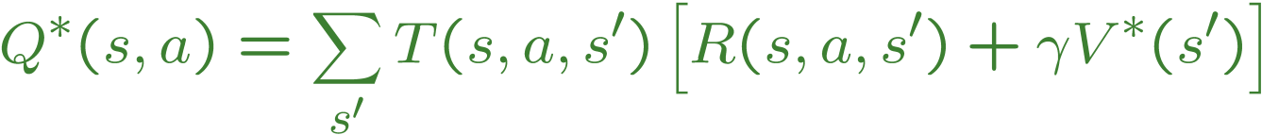
The Bellman Equations
Definition of “optimal utility” via heuristic recurrence gives a simple one-step lookahead relationship amongst optimal utility values
These are the Bellman equations for optimization of the utility function in dynamic programming
s
a
s, a
s,a,s’
s’
Notes:
Let’s start by equations that characterize these quantities through mutual recursions. [step through this by writing on slide, one step at a time]
Recursive characterization of V* in terms of V*; not necessarily helpful; but it is a characterization.
Note: this is a set of equations that needs to be satisfied; but it could have multiple solutions (it does not, but at this stage of our knowledge it could).

Slide 6
Bellman Equations vs. Value Iteration
Bellman equations characterize the optimal values:
Value iteration computes them:
Value iteration leads to a fixed point solution of the
Bellman equation (when further iterations do not change
the subsequent results)
V(s)
a
s, a
s,a,s’
V(s’)
Notes:
Discuss computational complexity: S * A * S times number of iterations
Note: updates not in place [if in place, it means something else and not even clear what it means]

Slide 7
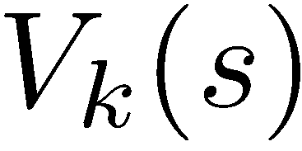
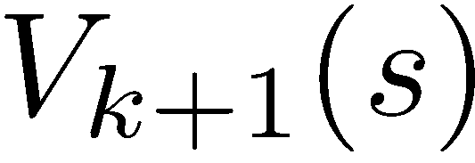
Convergence*
Theorem: The utility values will converge to unique optimal values
Basic idea: approximations get refined towards optimal values
Computational meaning of the theorem
We can compute the utilities iteratively
We can start with arbitrary initial value – the computation will converge towards the end of the computation any way
The policy may converge long before the values do, so the better choice, the faster we can find the policy

Slide 8
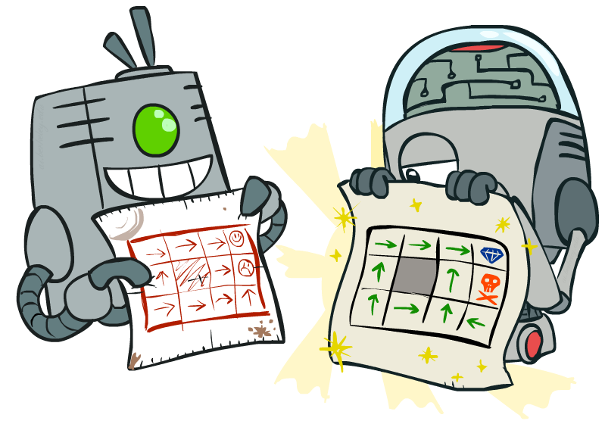
Policy Optimization

Slide 9
Optimal policy vs. Fixed Policy
Do the optimal action
Do what π says to do
s
s
a
π(s)
s, a
s, π(s)
s,a,s’
s, π(s),s’
s’
s’
Optimal policy such as heuristic search trees maximize over all actions to compute the optimal values
If we fixed some policy π(s), then the tree would be simpler – only one action per state

Slide 10
Utilities for a Fixed Policy
Another basic operation: compute the utility of a state s under a fixed (generally non-optimal) policy
Define the utility of a state s, under a fixed policy π:
V^{π}(s) = expected total discounted rewards starting in s and following π
Recursive relation (one-step look-ahead / Bellman equation):
s
π(s)
s, π(s)
s, π(s),s’
s’

Slide 11

Policy Evaluation
s
How do we calculate the V’s for a fixed policy π?
Idea 1: Turn recursive Bellman equations into updates
(like value iteration)
Efficiency: O(S²A) per iteration
Idea 2: Without the maximums, the Bellman equations are a linear system of equations
Solve with Matlab (or your favorite linear system solver)
π(s)
s, π(s)
s, π(s),s’
s’

Slide 12
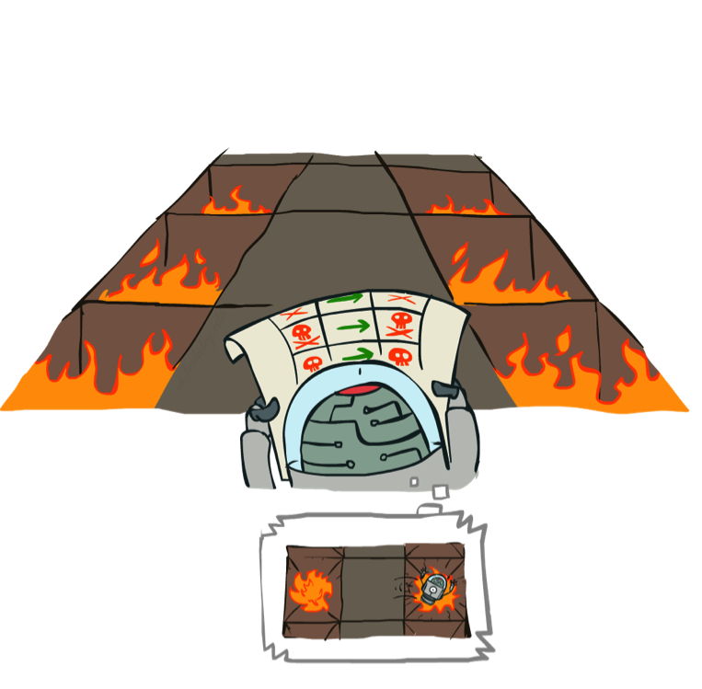
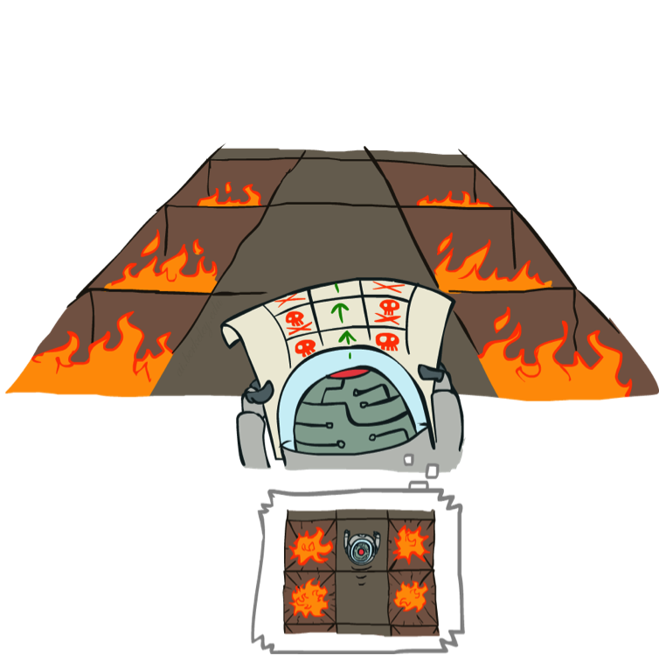
Example: Policy Evaluation
π₁: Always Go Right
π₂: Always Go Forward

Slide 13
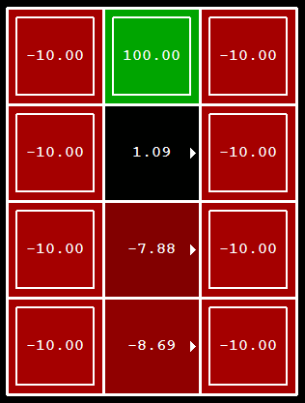
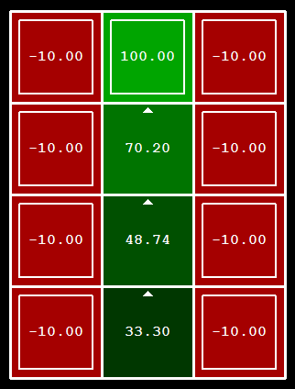
Example: Policy Evaluation
Always Go Right
Always Go Forward

Slide 14
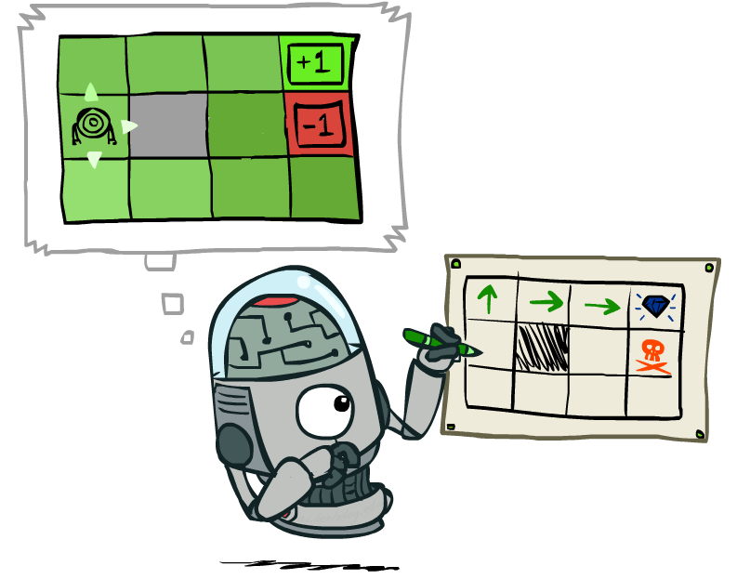
Policy Extraction

Slide 15
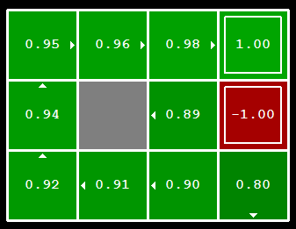

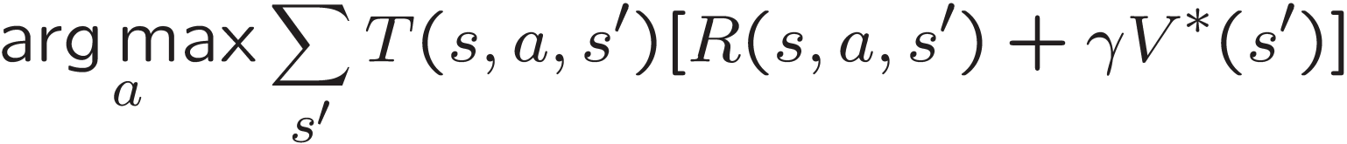
Computing Actions from Values
Let’s imagine we have the optimal values V*(s)
How should we act?
We need to do one step of the heuristic search to find out what to do next
This is called policy extraction, since it gets the policy
according to the calculated values

Slide 16
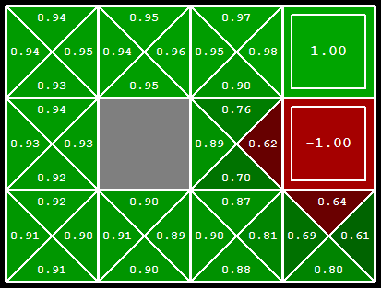
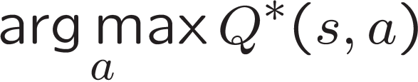
Computing Actions from Q-Values
Let’s imagine we have the optimal q-values:
How should we act?
In this case we can simply apply the policy to chose
Important lesson: actions are easier to select from q-values than values!

Slide 17

Policy Iteration

Slide 18
Problems with Value Iteration
Value iteration repeats the Bellman updates:
Problem 1: It’s slow – O(S²A) per iteration
Problem 2: The “max” at each state rarely changes, so lots of unnecessary calculations
Problem 3: The policy often converges long before the values get optimal, so no need to continue
s
a
s, a
s,a,s’
s’
[Demo: value iteration (L9D2)]
Notes:
Demo steps through value iteration; snapshots of values shown on next slides.

Slide 19
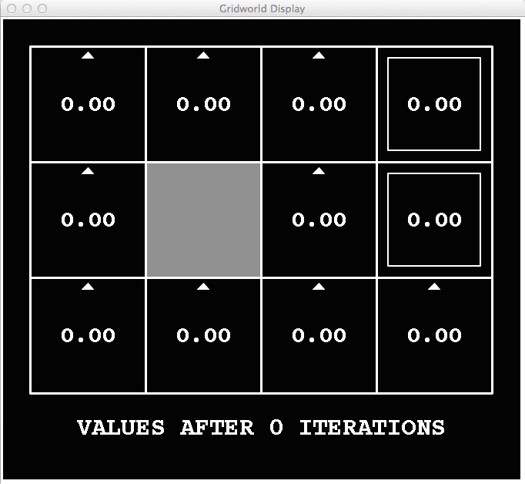
k=0
Noise = 0.2
Discount = 0.9
Living reward = 0
Notes:
Assuming zero living reward

Slide 20
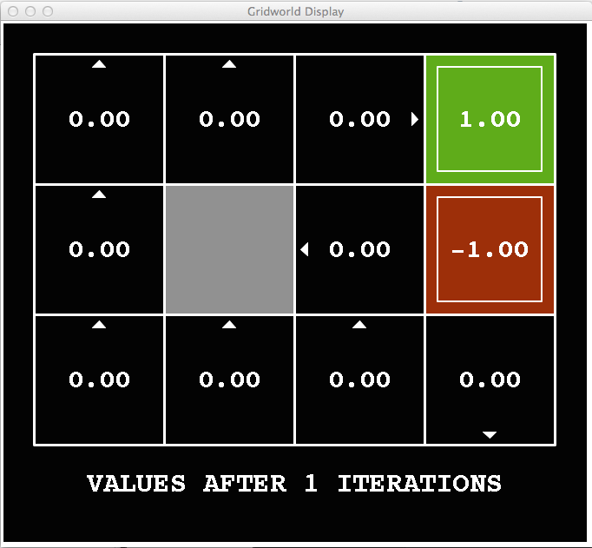
k=1
Noise = 0.2
Discount = 0.9
Living reward = 0
Notes:
Assuming zero living reward

Slide 21
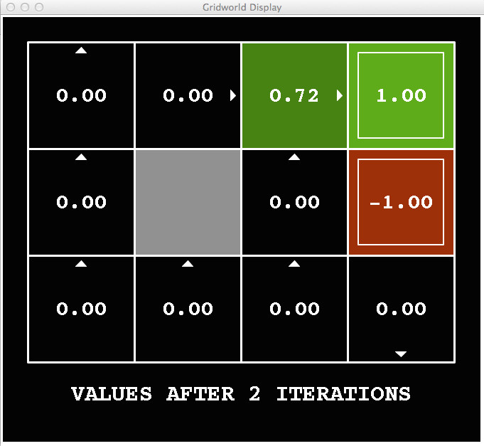
k=2
Noise = 0.2
Discount = 0.9
Living reward = 0
Notes:
Assuming zero living reward

Slide 22
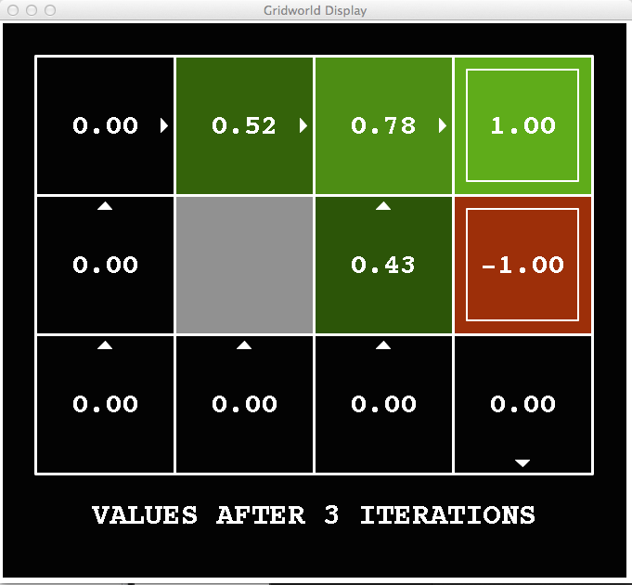
k=3
Noise = 0.2
Discount = 0.9
Living reward = 0
Notes:
Assuming zero living reward

Slide 23
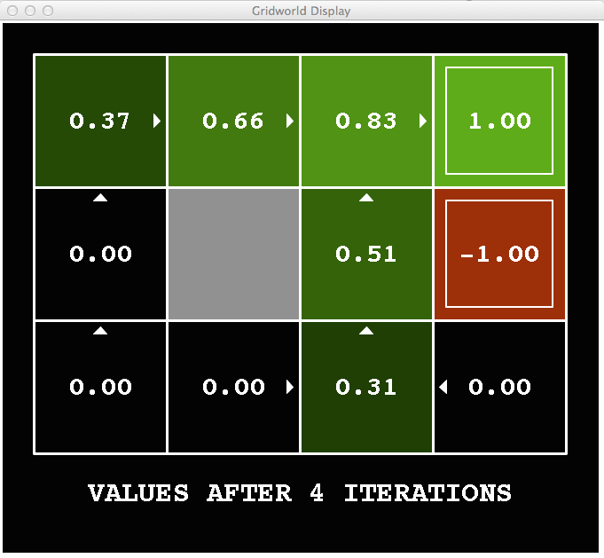
k=4
Noise = 0.2
Discount = 0.9
Living reward = 0
Notes:
Assuming zero living reward

Slide 24
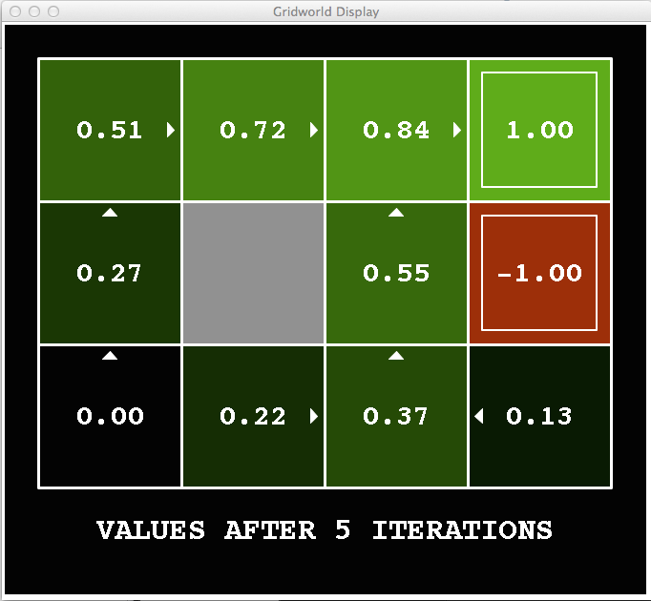
k=5
Noise = 0.2
Discount = 0.9
Living reward = 0
Notes:
Assuming zero living reward

Slide 25
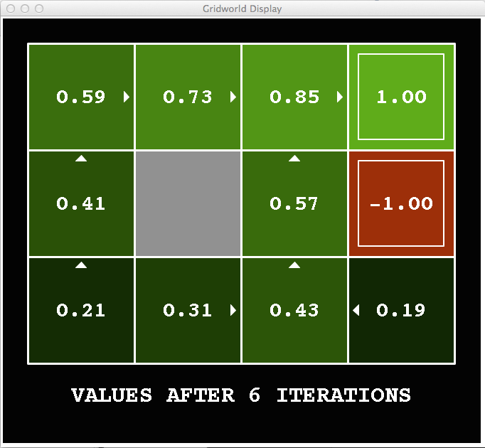
k=6
Noise = 0.2
Discount = 0.9
Living reward = 0
Notes:
Assuming zero living reward

Slide 26
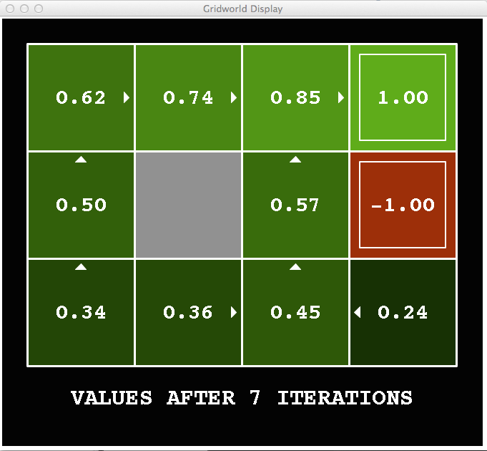
k=7
Noise = 0.2
Discount = 0.9
Living reward = 0
Notes:
Assuming zero living reward

Slide 27
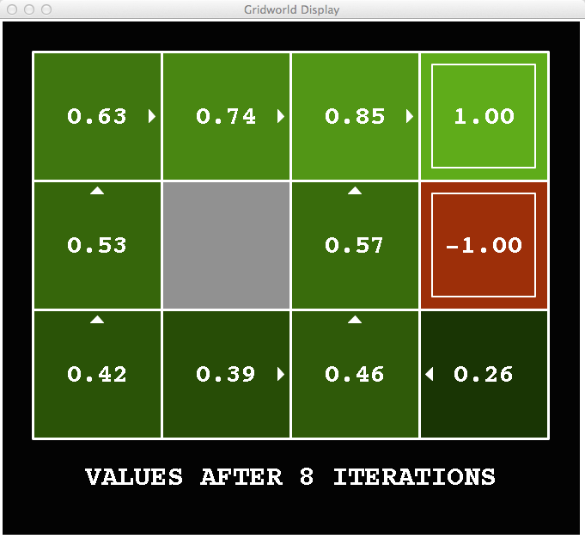
k=8
Noise = 0.2
Discount = 0.9
Living reward = 0
Notes:
Assuming zero living reward

Slide 28
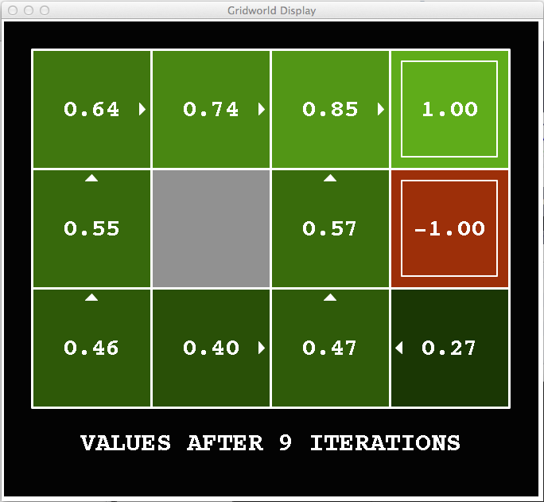
k=9
Noise = 0.2
Discount = 0.9
Living reward = 0
Notes:
Assuming zero living reward

Slide 29

k=10
Noise = 0.2
Discount = 0.9
Living reward = 0
Notes:
Assuming zero living reward

Slide 30

k=11
Noise = 0.2
Discount = 0.9
Living reward = 0
Notes:
Assuming zero living reward

Slide 31
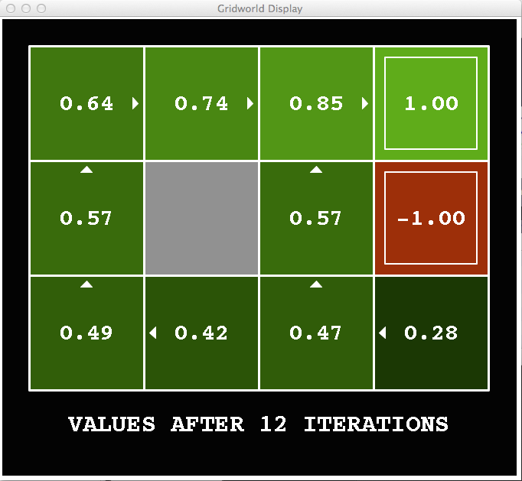
k=12
Noise = 0.2
Discount = 0.9
Living reward = 0
Notes:
Assuming zero living reward

Slide 32

k=100
Noise = 0.2
Discount = 0.9
Living reward = 0
Notes:
Assuming zero living reward

Slide 33
Policy Iteration
Alternative approach for calculating optimal values:
Step 1: Policy evaluation: calculate utilities for some fixed policy (not optimal utilities!) until convergence
Step 2: Policy improvement: update policy using one-step look-ahead with resulting converged (but not optimal!) utilities as future values
Repeat steps until policy converges
This is policy iteration
It’s still optimal!
Can converge (much) faster under some conditions

Slide 34
Policy Iteration
Policy evaluation: For fixed current policy π, find values with policy evaluation:
Iterate until values converge:
Policy Improvement: For fixed values, get a better policy looking one step ahead:
Calculate one-step look-ahead:

Slide 35
Value Iteration vs. Policy Iteration
Both value iteration and policy iteration compute the same thing (all optimal values)
In value iteration:
Every iteration updates both the values and (implicitly) the policy
We don’t track the policy, but taking the max over actions implicitly recomputes it
In policy iteration:
We do several passes that update utilities with fixed policy (each pass is fast because we consider only one action, not all of them)
After the policy is evaluated, a new policy is chosen (slow like a value iteration pass)
The new policy will be better (or we’re done)
Both are dynamic programs for solving MDPs

Slide 36
Partially Observable MDP (POMDP)
Extension of the MDP model by adding
A set of observations in the states z ∈ Z
A set of probabilities of the occurrence of observations z in a state s t(s | z)
Solution of the POMDP by
Reduction to MDP and applying dynamic programming method for maximization of the utility
Using approximate methods for searching the optimal policy

Slide 37
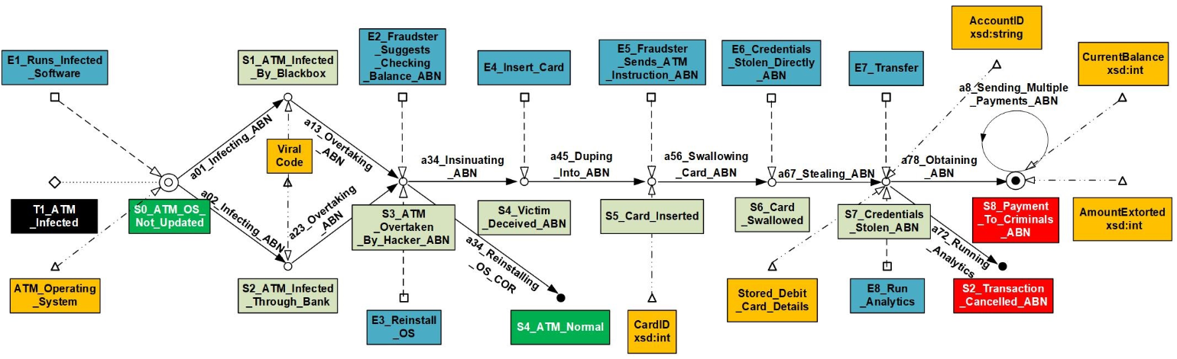
Example: Transaction control under security threats

